Slide 1
Process Analysis

Slide 2
Process analysis explains how to do something (play a computer game, change a tire), how to make something (a butterfly sanctuary), or how something happens (how the modern firehouse has evolved).
Specifically, it explains a sequence of actions with a specified result (the process) by dividing it into its component steps (the analysis). Basically, it answers the question how something happens.
(The Compact Reader: Short Essays by Method and Theme)

Slide 3
We perform various processes every day
Making a cup of coffee, flossing our teeth, taking a picture, withdrawing money from an ATM etc.
Sharing special technique for doing something – for example, how you download videos from YouTube

Slide 4
Three main kinds of processes
Historic
Advisory
Scientific

Slide 5
Historic
Common in textbooks and articles
Its goal is to explain how something happened - how a social change occurred, a law was passed or a war began.
It is often chronological, but can often be organized by importance.
e.g.
How the meltdown of Chernobyl affected the stock market

Slide 6
Geological Survey of India Report
From 14 to 17 June 2013, Uttarakhand and adjoining areas experienced heavy rainfall, which was about 375 percent more than the benchmark rainfall during a normal monsoon. This caused the meIting of Chorabari Glacier at the height of 3800 metres, and eruption of the Mandakini River which led to heavy floods near Gobindghat, Kedar Dome, Rudraprayag district, Uttarakhand and adjacent areas. It was also observed that very heavy and incessant rains during the period resulted in exceptionally high rise in the river discharges.

Slide 7
The rise in the river level was of the order of 5 - 7m where the valley was wide and 10 - 12m where the valley was narrow. In the upper stretches of Mandakini, the stream gradient is high and valley profile is mostly narrow. The gush of water running down from Kedarnath and Rambara areas brought mammoth sediment load consisting of huge rock boulders (diameter ranging from 3 to 10 m). The heavy sediment load along with big boulders acted as tools of destruction and took away everything that came in their way. The enormous volume of water induced toe erosion along all the river valleys which in turn triggered landslides at a number of places

Slide 8
Advisory
This style is often seen is "self-help" books.
Anyone with a clear opinion can write this well; you don't have to be an "expert."
It is personal and it explores the feelings and values of the person giving advice.
It can be chronological, but is usually organized by importance.
e.g.
• How to end a bad relationship

Slide 9
It’s not rocket science: How to choose your life partner Gail Brenner
If you are like me, no one ever sat you down and instructed you on how to choose a life partner. Yet, this is one of the most critical decisions we will ever make in life – with potentially huge repercussions for a less-than-ideal choice. A long-term relationship can be one of the most joyous and fulfilling experiences life has to offer. Here is what you need to know to choose the life partner who is right for you.

Slide 10
Consider qualities that are important to you: First, become familiar with the qualities that you desire in a partner. It doesn’t matter what they are – what matters is that you are consciously aware of what is important to you. Two qualities you might seriously consider are honesty and openness/flexibility. You need to be able to trust your partner to be straight up with you – about money, preferences, things they are doing, people they are spending time with. In addition, you will want to choose someone who is open to examining themselves, willing to take responsibility for their own behavior, and able to move with the ebbs and flows of life.

Slide 11
Know your deal breakers: Only you can know your bottom line. You deserve to be with someone who is truly interested in making your relationship thrive. If you are mistreated or disrespected in any way, think twice before moving forward. Take very seriously problems such as addiction, large debt, uncontrollable emotions, or severe mental illness. You can have tremendous compassion for people with these issues, but the likelihood of being in a satisfying relationship with them is negligible.

Slide 12
Scientific or natural
This style is often used in textbooks, of course.
The goal is to teach us about a process in the world that may be invisible to us. It is almost always chronological in organization.
Examples :
• How photosynthesis works
• How clouds form
• How global warming leads to ocean acidification

Slide 13
Writing a process analysis
Two main categories
Processes for readers who will perform them (directional)
Processes for readers who won’t perform them (informational)

Slide 14
Processes for readers who will perform them
May be technical or professional personnel
Need information to carry out a work-related task or to perform something for themselves
A how-to-do-it paper
Includes everything a reader needs to know to ensure a successful outcome
Usually polite commands
Technical/ user manuals

Slide 15
How to Remove Chewing Gum From Hair
First, prepare an ice sack. Place several cubes of ice in a plastic bag or thin cloth. Seal it.
Move the affected hair away from the scalp and apply ice pack to hair. Do so for 15 to 30 minutes or until the gum freezes solid. Use a rubber glove to hold the ice if your hand becomes chilled.
With one hand, hold the stuck section of the hair between the gum clot and the scalp. Crack the frozen gum into pieces with another hand.
Gently pull the frozen gum pieces from the hair. If the warmth of your hand begins to melt the gum, refreeze and repeat the steps.

Slide 16
(Joshua Piven et al., The Worst-Case Scenario Survival Handbook: Parenting. Chronicle Books, 2003)

Slide 17
User manual
OnePlus5 cell phone

Slide 18
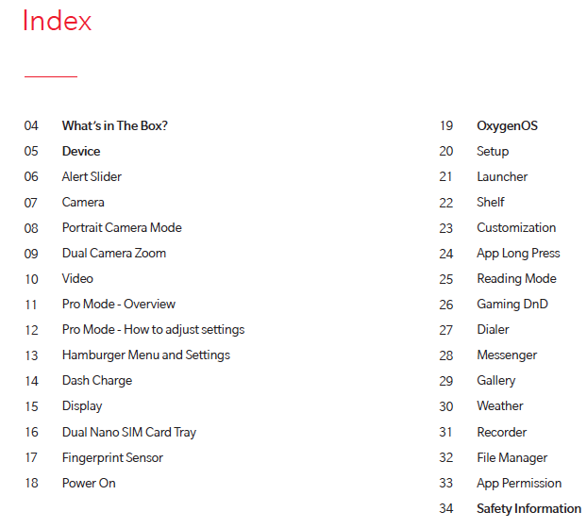

Slide 19
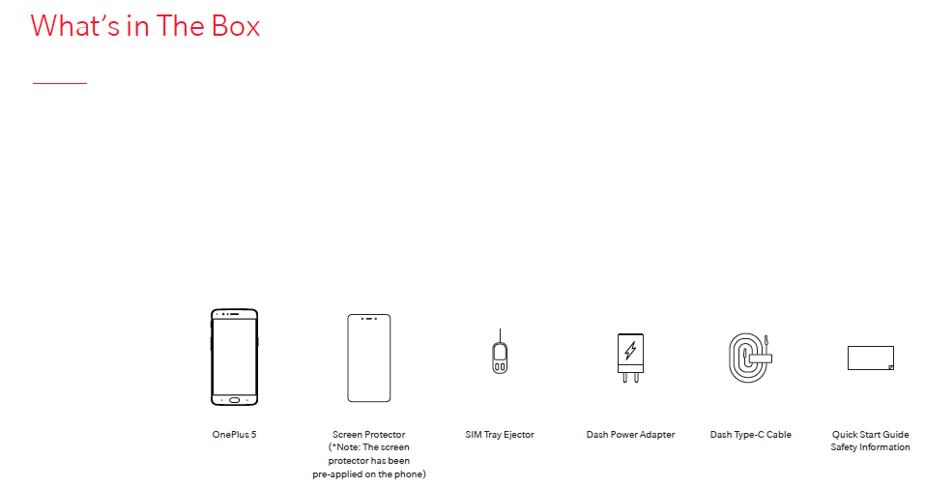

Slide 20
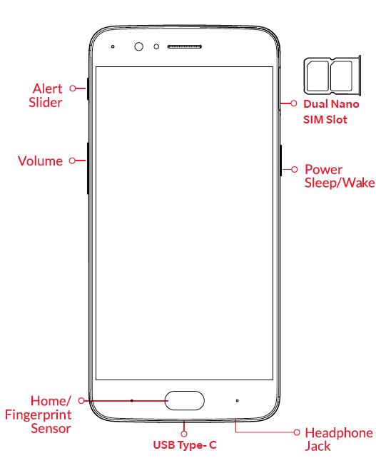

Slide 21
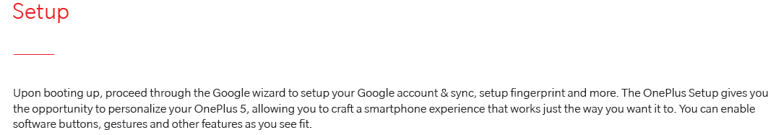


Slide 22
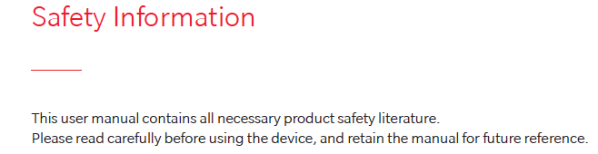

Slide 23
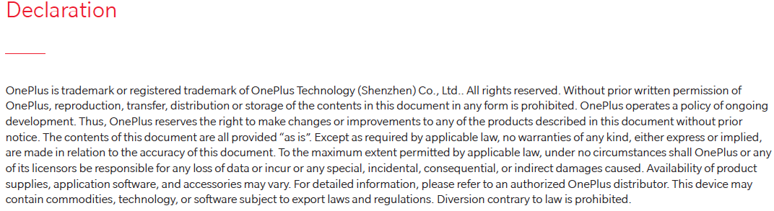

Slide 24
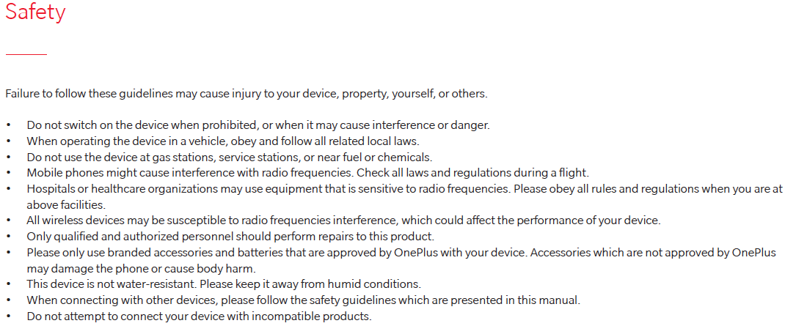

Slide 25
Be sure to include all steps and arrange them in sequence.
Explain why each step is necessary, and include warnings where appropriate.
Define any terms that your readers may not be familiar with.
Offer clear descriptions of any tools, materials, or equipment needed to carry out the process.
Provide your readers with a way of determining whether or not the process has been carried out successfully.

Slide 26
Ensure that the reader can duplicate the process or understand how it unfolds
Fully detail each step and specify the reasons for it
Make it clear to the reader the sequence of steps, their duration, and where they occur.
The chronology may contain occasional interruptions or modifications - it may require background information, definitions of specialized terms, examples, etc.

Slide 27
Processes for readers who won’t perform them
Explain how a process is performed or how some phenomenon occurs
Research papers, textbooks, reading materials, encyclopedias

Slide 28
No polite commands
Pronouns used to refer to a performer
Unidentified performer

Slide 29
How reflex arcs work
Reflex arcs are connections between sensory neurons, the spinal cord, and motor neurons. They are good examples of how the nervous system protects you by making you get out of danger almost before you realize you are in danger.
Here’s an example: You are cooking dinner, and you accidentally grab the lid of a pot without using a hot pad. You just want to check on the vegetables. Your nervous system has other ideas:

Slide 30
When you grab that hot lid, the endings of the sensory nerves in your skin detect the heat and send an impulse up through the axon of a sensory neuron to the nerve cell body of the sensory neuron.
The impulse continues through sensory neurons until it reaches an interneuron in the spinal cord. The interneuron determines the appropriate response — which, in this case, would be stimulating the muscles to pull your hand away.
The excitatory impulse is transferred to the cell body of a motor neuron and travels down the axon of the motor neuron until it reaches muscle tissue. The muscle responds by contracting to pull your hand away from the hot lid.

Slide 31
With all these words describing what happens, it makes it seem like this process takes quite a while. But think about when you’ve touched something hot by mistake. You pulled your hand away immediately thanks to a quick-reacting reflex arc. Without the reflex arc protecting you, you might just unknowingly hold that hot lid in your hand until real damage is done!
(www.dummies.com)

Slide 32
A sample text

Slide 33
Writing a process analysis
List phases/ stages/ steps and identify every important action

Slide 34
Think of a proper sequence – chronological or relative importance
Use transition words
Mostly present tense
Using passive voice – more formal

Slide 35
Transition words
For the first step, For the second step, (and so on) Next, Then, Following this, After, Afterwards, After this, Subsequently, At the same time, | Most importantly, Crucially, Furthermore, Additionally, Of secondary importance, Of equal importance, Simultaneously, Concurrently, While that is happening, During this time | Finally, For the final step, Ultimately, Before you are done, One last point is,

Slide 36
A process analysis thesis should contain two elements: (1) the main point of the analysis and, (2) the organizational format for exploring the main idea.
If possible, it also previews the stages in the process.
E.g. Building a table is a simple, three-stage process of cutting, assembling, and finishing.
In this example, the main point of the process is reflected in the word simple, which suggests the ease of the process. The words cutting, assembling, and finishing obviously suggest the stages.

Slide 37
Changing a tire does not require a mechanic’s skill: on the contrary, a ten-year-old child can do it. (emphasizes its ease)
The overly complicated registration procedure forces students to waste time standing in long lines.

Slide 38
Choose one of the topics and write a process analysis in about 350 words.
How to break a bad habit (directional)
How to become rich (directional)
Any natural/ scientific phenomenon you are familiar with (informational)

